Slide 1
Android Program Design —Water Quality Inspection Enquiry as4.1
Chen Yongyu1801050025

Slide 2
CONTENTS
01
Design Ideas
02
Log in Design
03
Program Interface Design
04
Interaction Design

Slide 3
Design Ideas
01

Slide 4
Design Ideas
To design a similar to the weather forecast of app, the app can know different local water quality, at present, this kind of app is less on the market, because the current capacity is low, so only design out an app can query water quality, in the future, the app can be further development, can even be a protection of water resources of the app.

Slide 5
Log in Design
02

Slide 6
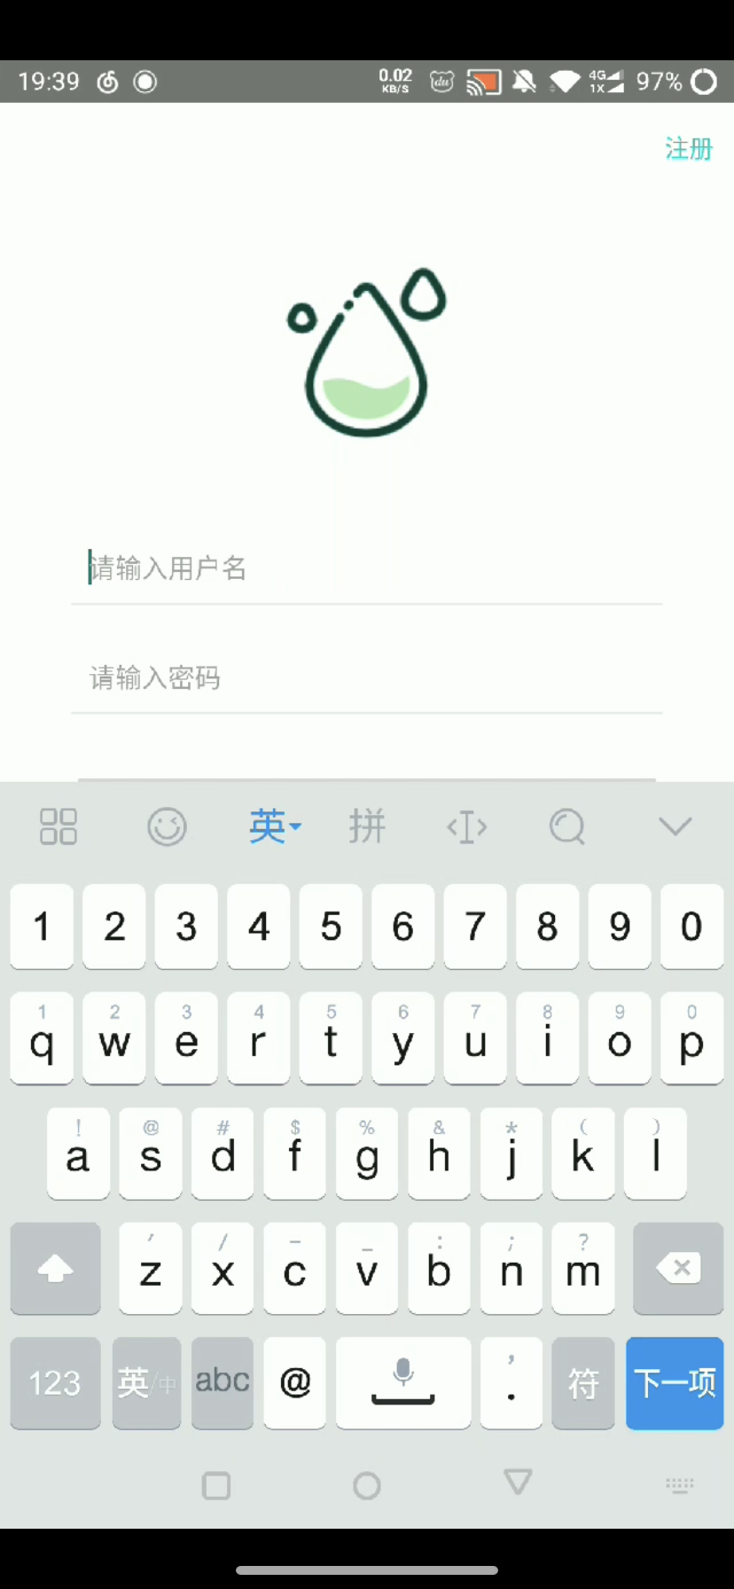
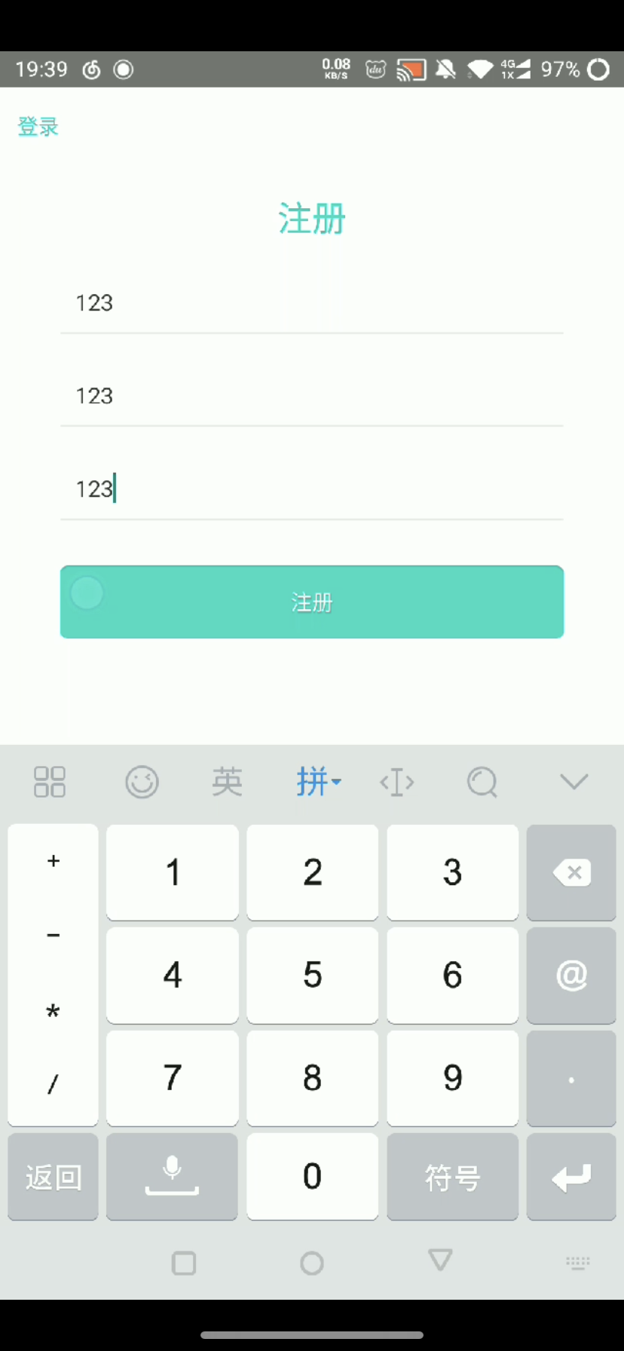
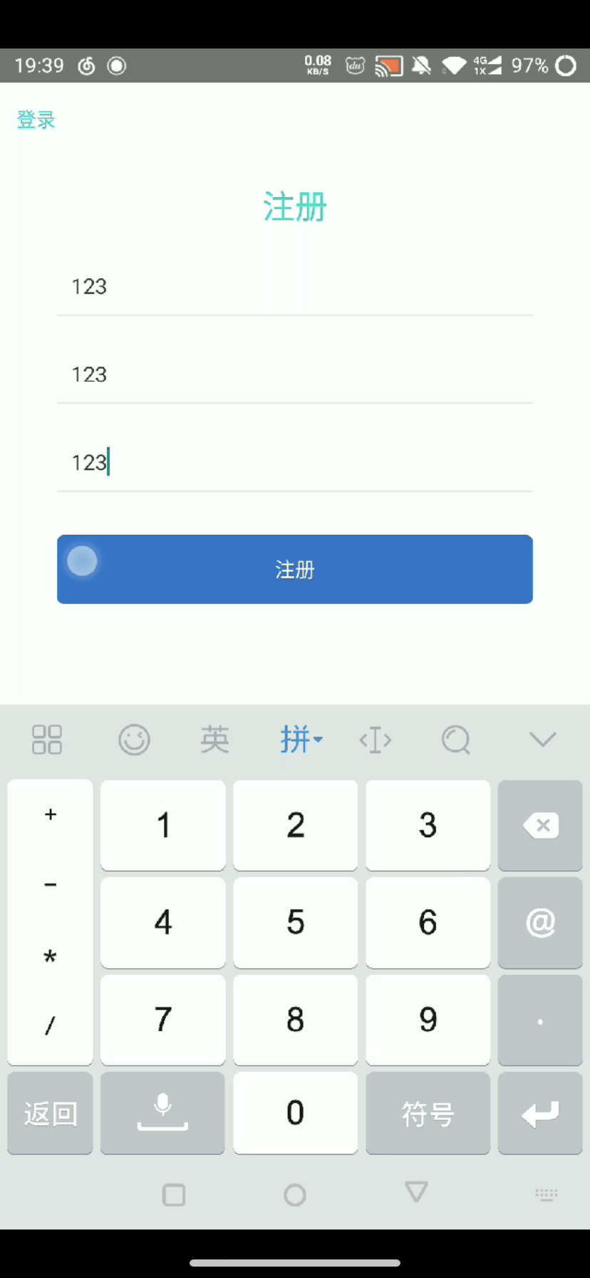
Log in Design
The whole APP is about water quality detection, so the color matching is mainly blue-green, giving people a clear and bright feeling.
Click the register button, can enter into the interface of the registered account.
After entering to the registration screen, click the register button to submit input information, and the button is changed from green to blue.

Slide 7
Program Interface Design
03

Slide 8
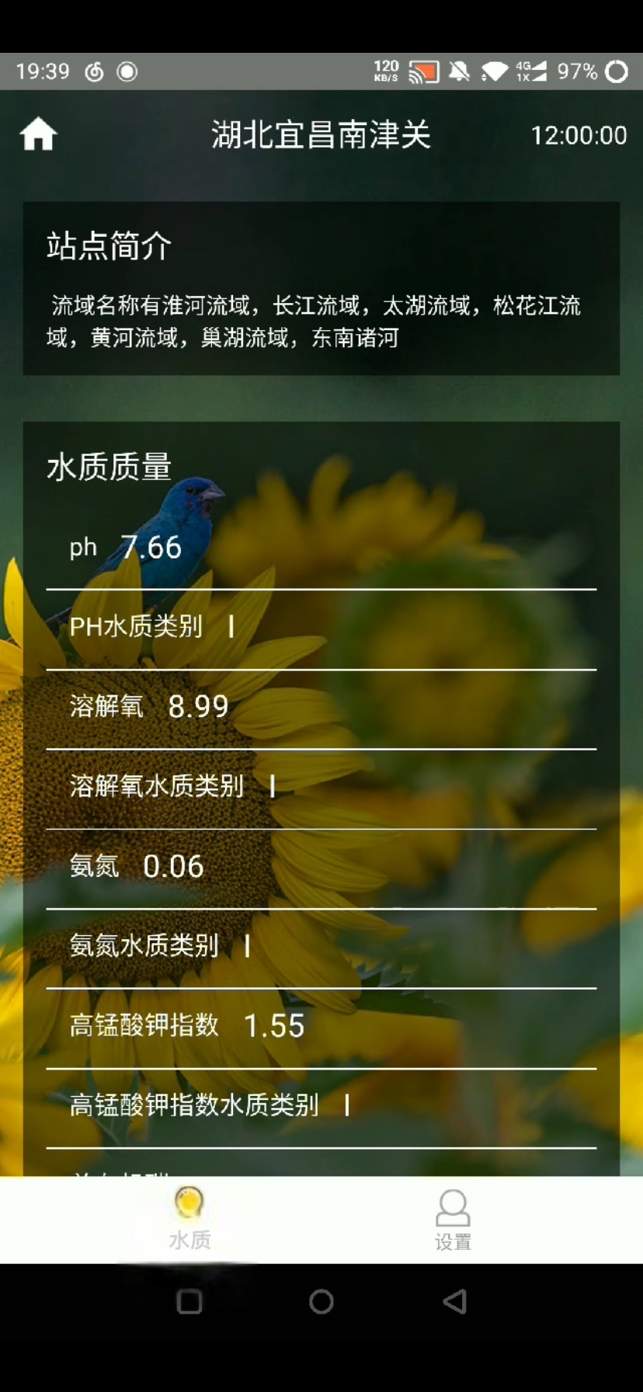
Program Interface Design
Program interface design water interface is mainly introduce the site and water quality.
The background design for the picture of the plant, give a person feel in nature.
Black design makes the overall look professional, formal sense.

Slide 9
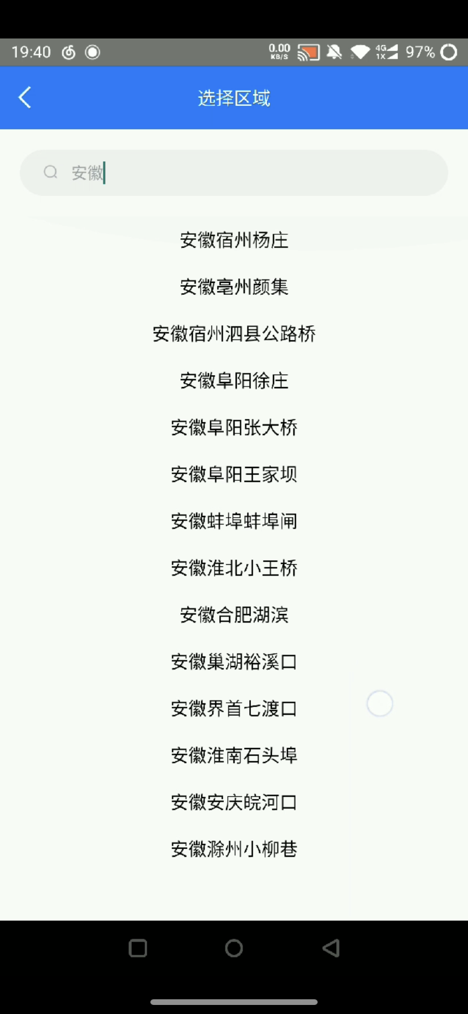
Program Interface Design
The navigation bar is also blue, and typing in a place name shows all the local sites

Slide 10
Interaction Design
04

Slide 11
Interaction Design
After logging in, a random site home page is the water quality of interface.
Click the small button can enter the house to the search interface.
The data is from the aggregated data.

